Slide 1
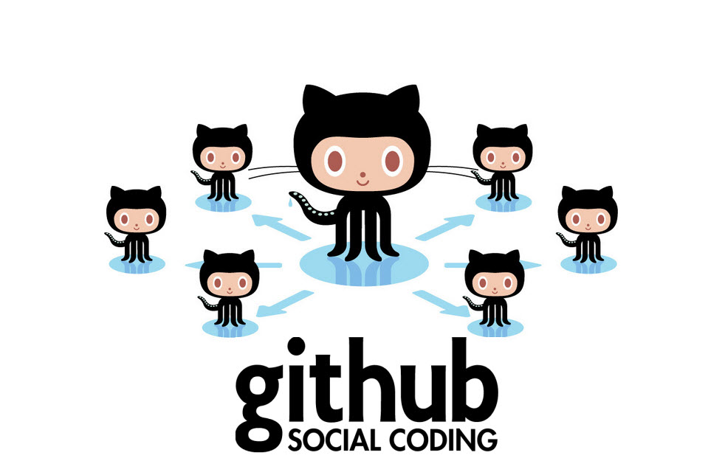
INTRODUCTION TO GITHUB
Name: Md.Saky
ID: 141014026

Slide 2
What is Git & Github ?
Git is the most commonly used version control system today and is quickly becoming the standard for version control. Git is a distributed version control system, meaning your local copy of code is a complete version control repository. These fully-functional local repositories make it is easy to work offline or remotely. You commit your work locally, and then sync your copy of the repository with the copy on the server. This paradigm differs from centralized version control where clients must synchronize code with a server before creating new versions of code.
GitHub is a website and service that we hear geeks rave about all the time, yet a lot of people don’t really understand what it does.

Slide 3

What is version control?
Distributed version control
Users keep entire code and history on their location machines
Users can make any changes without internet access
(Except pushing and pulling changes from a remote server)

Slide 4
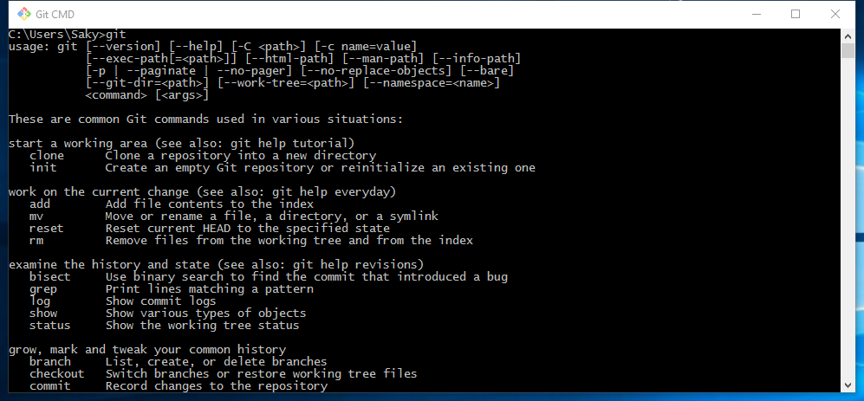

Slide 5
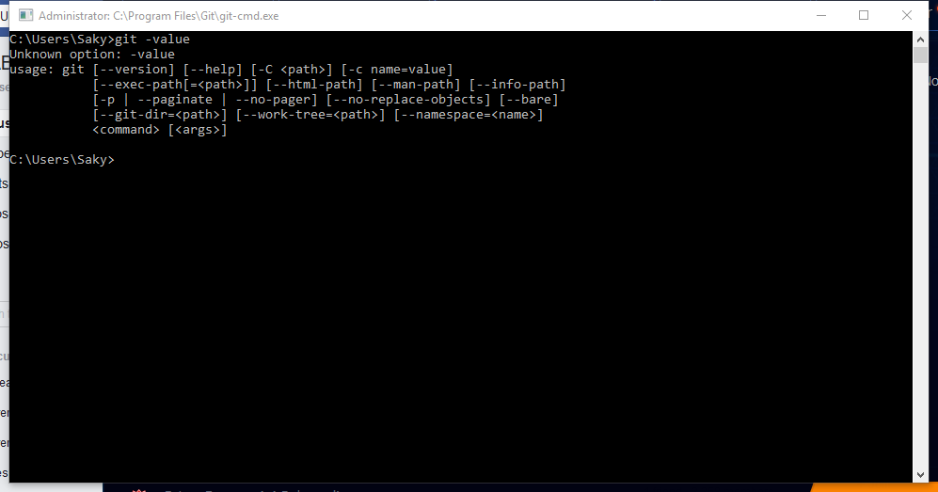

Slide 6

What is GitHub?
Founded in 2008
Also has an Enterprise edition for businesses

Slide 7
Install git and create a GitHub account
Create a local git repository
Add a new file to the repo
Add a file to the staging environment
Create a commit
Create a new branch
Push a branch to GitHub
Get changes on GitHub back to your computer

Slide 8
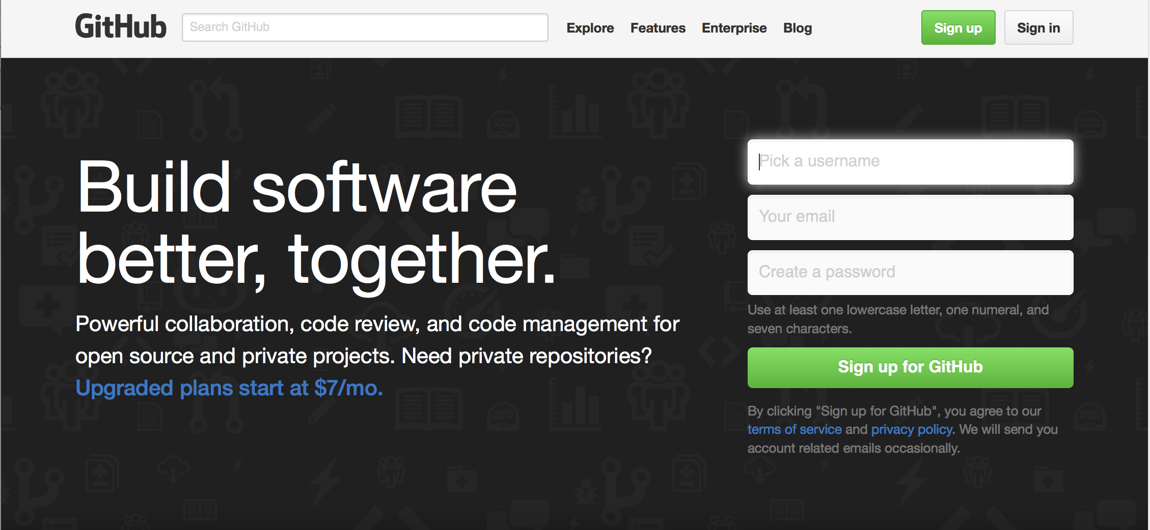
Create Github account • www.github.com • Free for public repositories

Slide 9
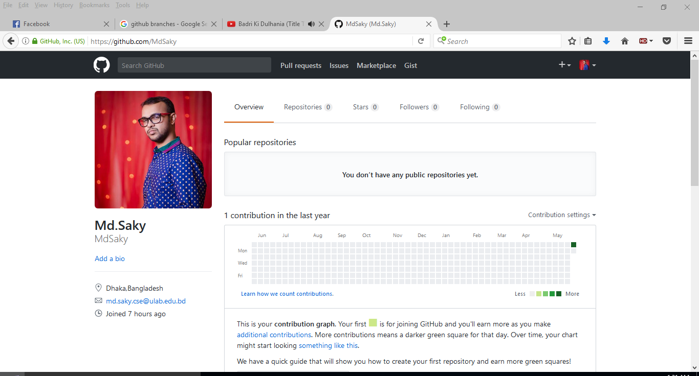

Slide 10
Branches
• All commits in git live on some
branch
• But there can be many, many
branches
• The main branch in a project is
called the master branch

Slide 11
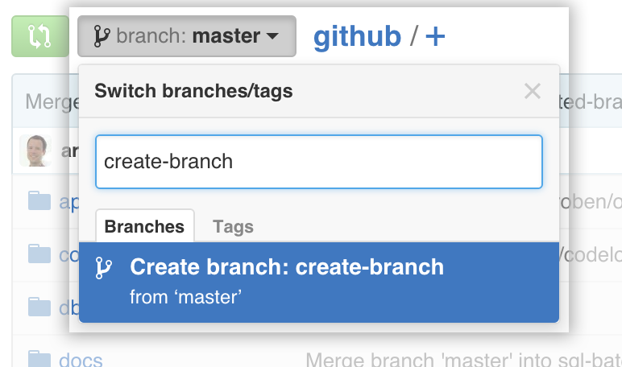
Create branch

Slide 12
Branching off of the master branch
The start of a branch points to a
specific commit
When you want to make any changes to your project you make a new branch based on a commit

Slide 13
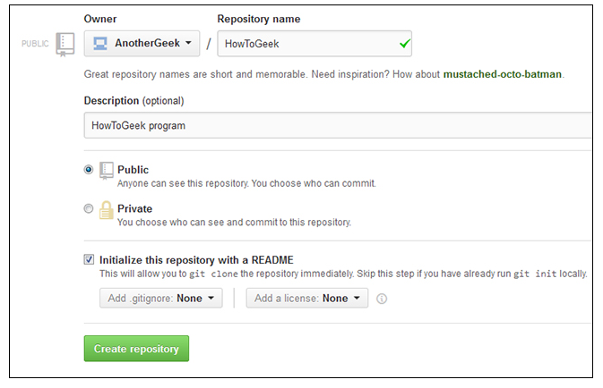
A repository is a location where all the files for a particular project are stored, usually abbreviated to “repo.” Each project will have its own repo, and can be accessed by a unique URL.

Slide 14
Some basic Terminology
git = the shell command to work with Git
repo = Repository, where the code for a given project is kept
commit = verb, means push the code to the server (in Git, commit = (commit + push)
diff = the difference between two versions of a file
SSH = Secure SHell – Network protocol for communication between machines
RSA = Rivest, Shamir, Adleman – public-key cryptography algorithm

Slide 15
THANK YOU

